Slide 1
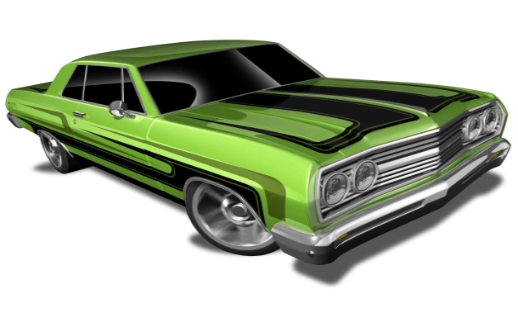
Automobile Pricing Model
Harsh Hareshkumar Shukla
Khushru Irani
Rama Mani Deepika Maram
Trupti Kirve
Nisarg Patel
Vivek Bhavsar

Slide 2
CONTENTS
Dataset and Variable definitions
Data Preprocessing
Goal
Methods
Conclusion
Possible Future work

Slide 3
Dataset and Variable definitions
This dataset was taken from: “https://archive.ics.uci.edu/ml/machine-learning-databases/autos/imports-85.names”
We have 26 variables in total, with 10 variables being Categorical, 1 ordinal and 15 are continuous
Just to give a small glimpse of our dataset the variable names are as follows:
Normalized_losses | Make | Fuel type | Aspiration
Number of doors | Body style | Drive wheels | Engine location
Wheel base | Length | Width | height
Curb weight | Engine type | Number of cylinders | Engine size
Fuel System | Bore | Stroke | Compression ratio
HorsePower | Peak RPM | City MPG | Highway MPG
Price |  | Symbolling
Notes:
The image is not clear either we can use manually created table for both slides or get a better picture

Slide 4
Exploratory Analysis
Cleaning and filling in Missing values
Price : From 205 observation we found 4 missing price values. Removed those 4 instances.
Normalized_losses : 37 missing values filled out using SPSS by using mean of nearby points.
No of Doors , Bore, Stroke, Horsepower and peak_rpm missing values were filled manually
Identifying Outliers:
Box-plot of Price vs Make was plotted to identify the outliers in the price
We found 1 of Dodge, 3 of Honda, 2 Mitsubishi, 1 of Plymouth and 4 of Toyota outliers.
We cannot just smooth out these values as we know, make have few models which are expensive.
Notes:
Which do you think would be convenient? In my perspective price will be best one since it’s our dependant variable

Slide 5
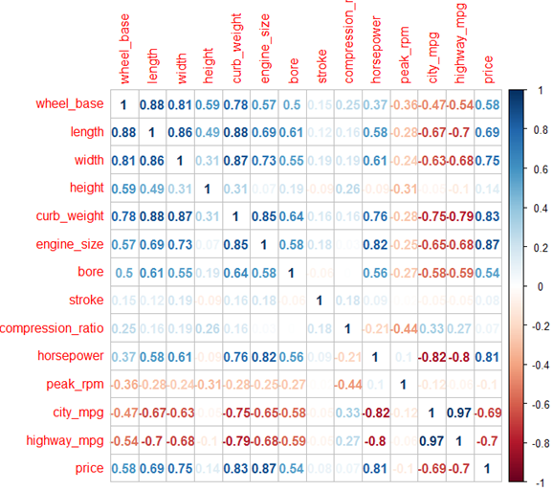
Data Preprocessing - Contd.
Correlations:
Correlation with value of 0.7 and above shows strong correlation.
length,width,curb_weight, wheel_base, engine_size, horsepower, city_mpg, highway_mpg, price variables are highly correlated.

Slide 6
Goals
Initial goal was to predict the price of the automobile using Linear Regression Model.
To come up with quality dataset, to get quality results we analyzed techniques like PCA, FA, CCA, CA so as understand the relationship between the variables and use these as input for the Linear Regression Model.
We also ended up classifying the Insurance risk ratings of the automobile using Decision Tree.
Notes:
Research question

Slide 7
Methods
Canonical Correlation Analysis
Correspondence Analysis
Principal Components Analysis
Common Factor Analysis
Linear Regression Model
Decision Tree

Slide 8
Canonical Correlation Analysis

Slide 9

Canonical Correlation Analysis
Preparing the dataset for CCA
Initial EDA technique used
No. of factors identified
Deciding the IV and DV
Performing CCA
Identifying the significance of covariates
CCA shows that variables like price, bore, curb_weight and city_mpg are highly related to each other.
Covariate 2 shows that height, compression-ratio shows relationship.

Slide 10
Canonical Correlation Analysis - Contd.
The covariates for Factor1 are calculated as below:
CV1 = -0.1066price -0.427wheel_base - 0.3404length + 0.2683width - 0.8385curb_weight + 0.0733engine_size - 0.127bore + 0.4913horsepower – 0.8489city_mpg + 0.067highwaympg
CV2 = 0.045price + 1.2850wheel_base + 0.6405length – 0.7960 width– 1.4545curb_weight - 0.4048engine_size – 0.1800bore + 0.5695horsepower – 0.3044city_mpg – 0.5747highwaympg
The covariates for Factor2 are calculated as below:
CV1 = 0.3023 symboling– 0.3681height – 0.4352compression_ratio + 0.3043peak_rpm
CV2 = -0.3181 symboling + 0.6701 height – 0.6016compression_ratio + 0.4005peak_rpm

Slide 11
Correspondence Analysis

Slide 12
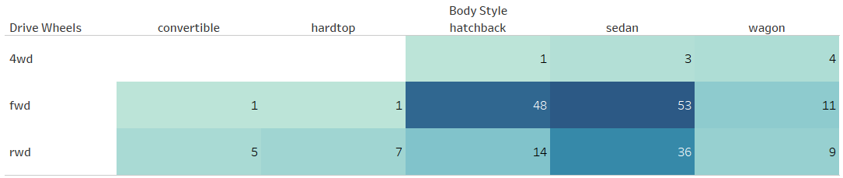
Correspondence Analysis
A Visual method
Starts with creating a contingency table:
.
Notes:
Correspondence analysis can be a very helpful tool to uncover the relationships among categorical variables and generate hypotheses for future analyses

Slide 13
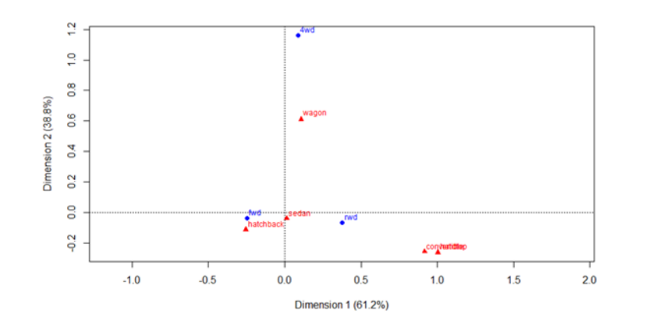
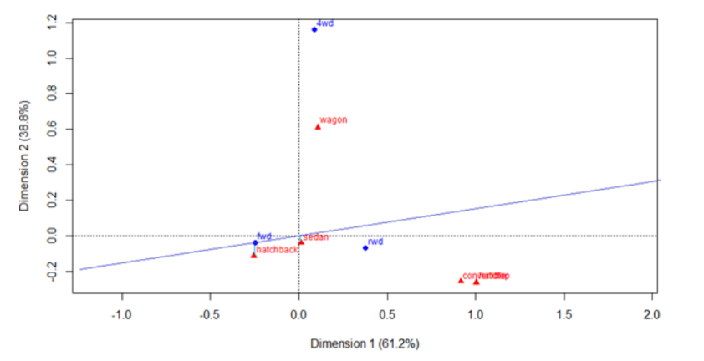
Correspondence Analysis - Contd.
The 2 categorical variables(body_styles vs drive wheels) is as seen in the plot.
We can infer that more hatchbacks and sedan correspond to fwd drive wheel type of vehicles.

Slide 14
Principal Components Analysis

Slide 15
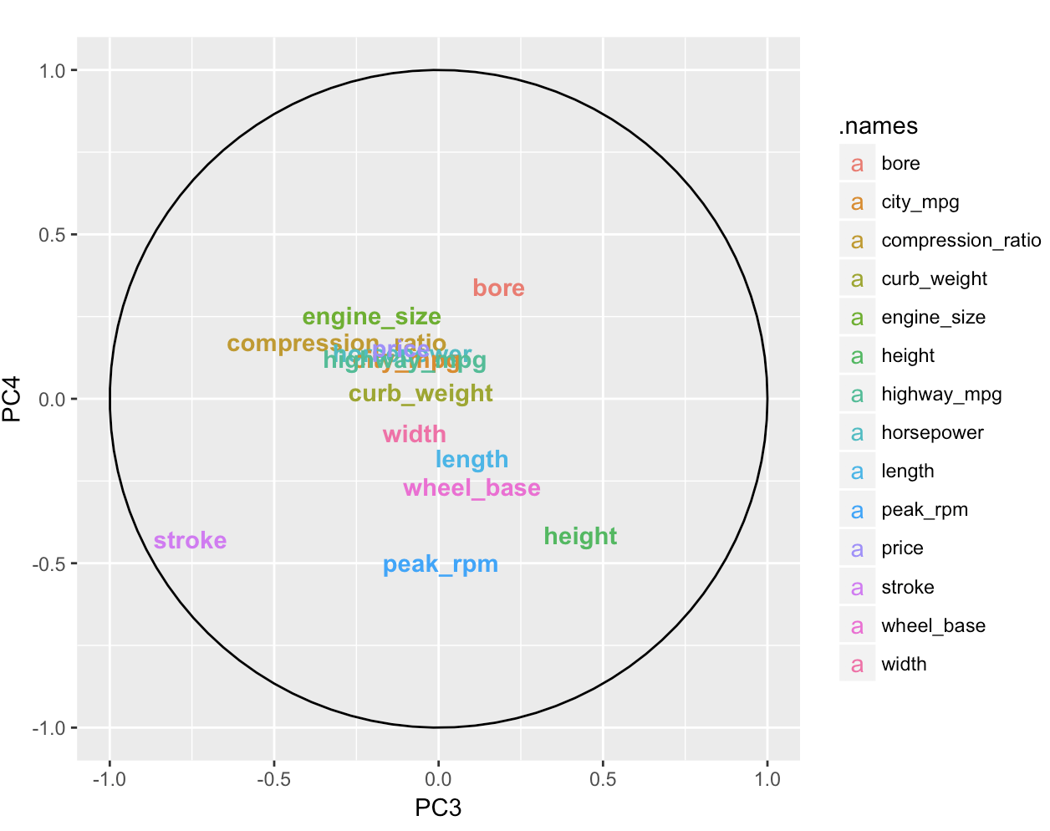
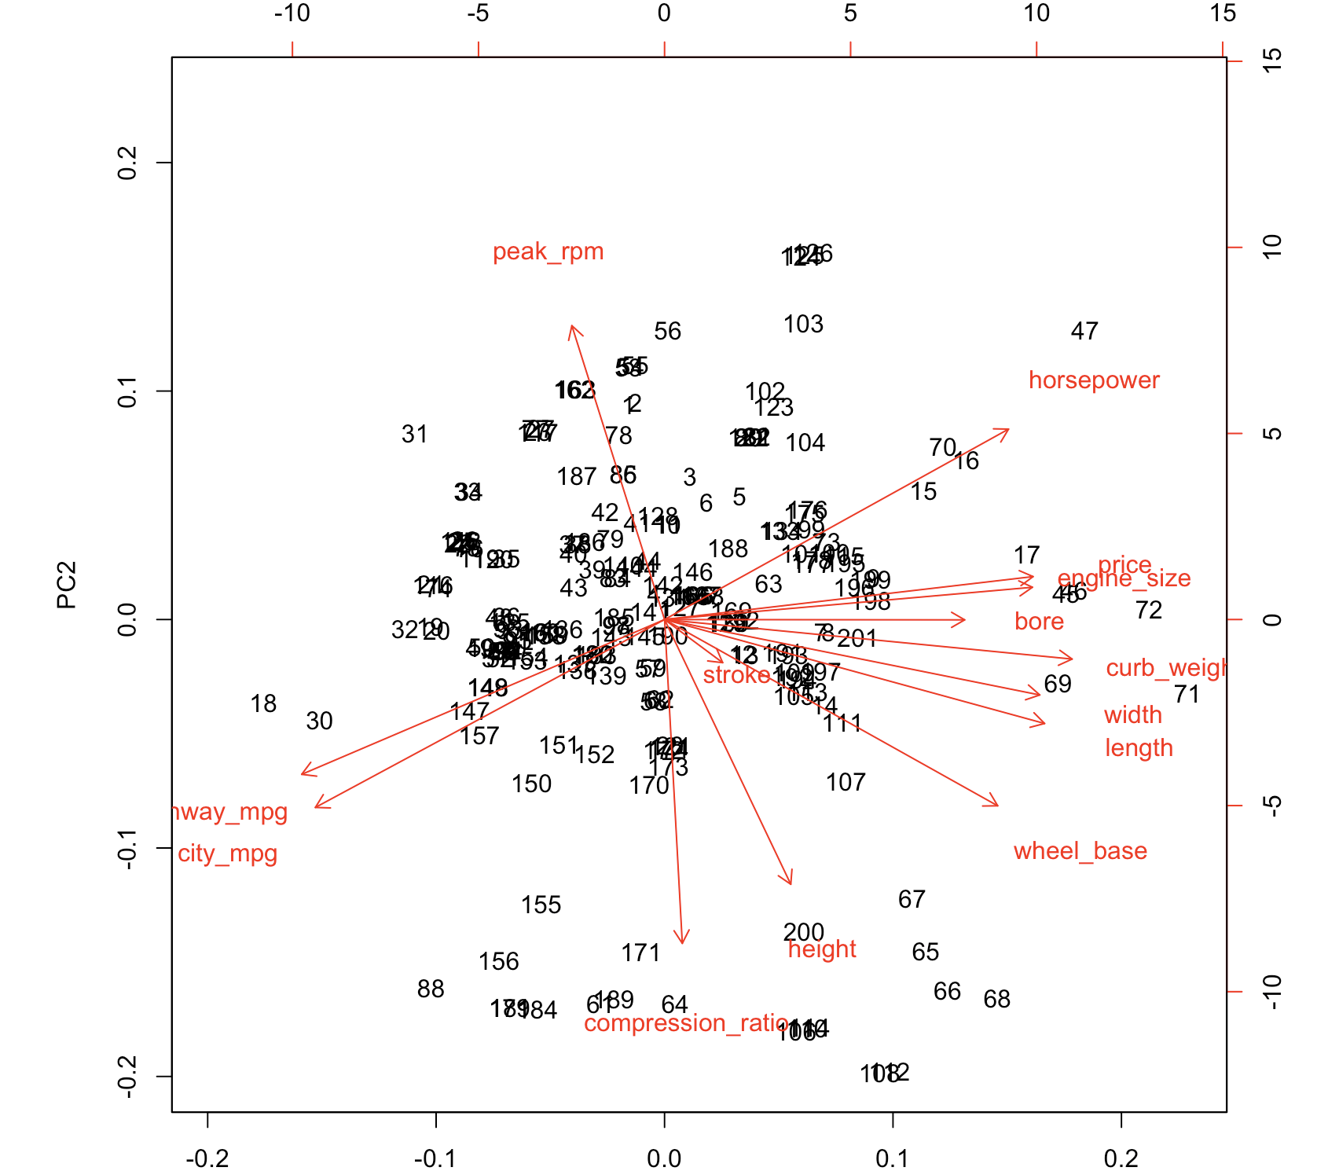
Principal Components Analysis
Principal Component Analysis: We have investigated PCA in two directions i.e., with and without using Dummy Variables.
PCA PLOT
BI-PLOT
Notes:
Wheel_base
Length
Width
curb_weight
Engine_size Bore Horsepower City_mpg Highway_mpg price

Slide 16
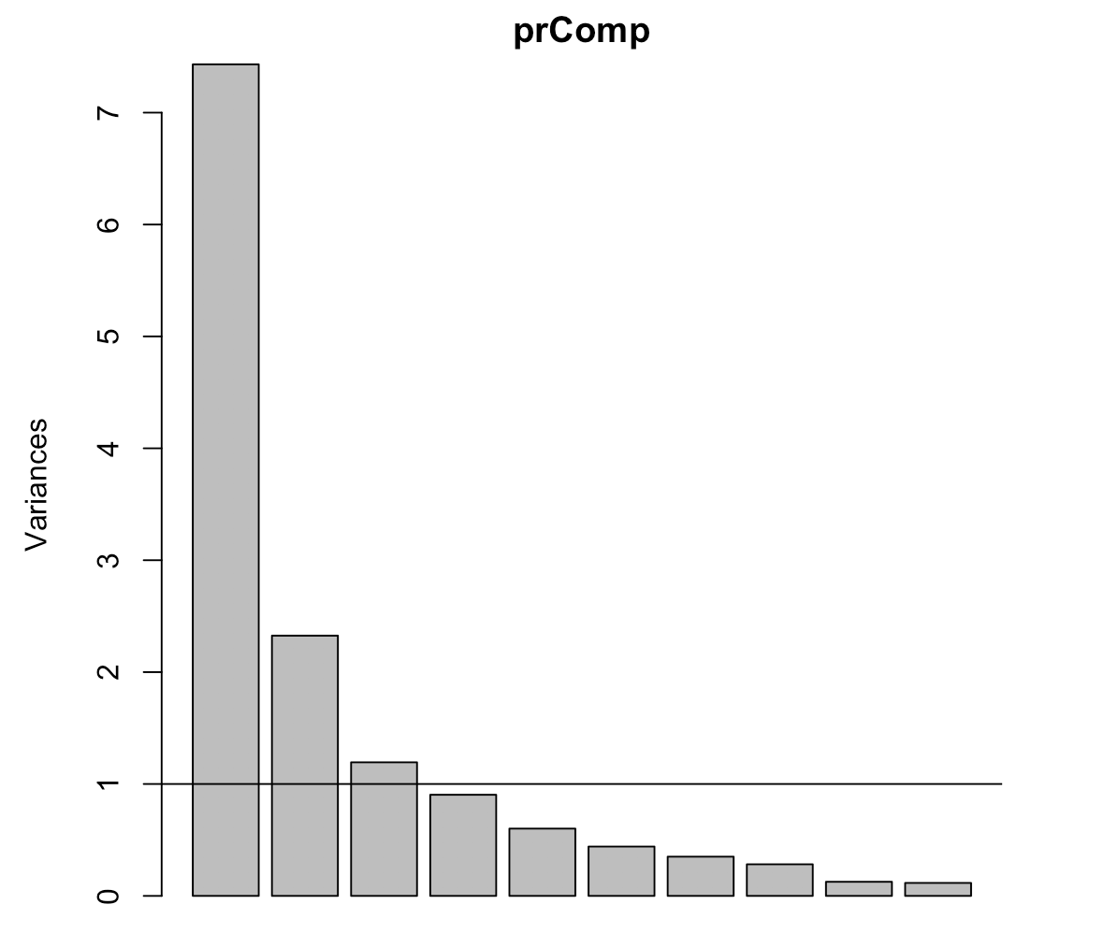
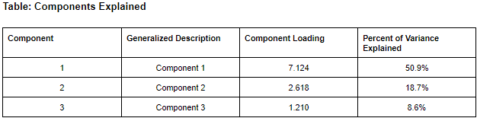
Principal Components Analysis-Contd.
100% variance was explained by 14 Components, but with the help of Kaiser-Meyer method, we selected 3 components.
PCA EQUATION:
Component 1 = 0.657 wheel_base + 0.813 length + 0.818 width + 0.913 curb_weight + 0.863 engine_size + 0.690 bore + 0.901 horsepower - 0.912 city_mpg - 0.924 highway_mpg + 0.871 price
Component 2 = 0.726 height + 0.715 compression_ratio - 0.724 peak_rpm
Component 3 = 0.834 stroke
Notes:
Wheel_base, Length, Width, curb_weight, Engine_size, Bore, Horsepower, City_mpg, Highway_mpg, price
Height
Compression_ratio
Peak_rpm
Stroke

Slide 17
Principal Components Analysis-Contd.
 | PC1 | PC2 | PC3
Component 1
Wheel_base | 0.657 | 0.630
Length | 0.813 | 0.469
Width | 0.818 | 0.381 | 0.122
curb_weight | 0.913 | 0.320
engine_size | 0.863 | 0.116 | 0.237
bore | 0.690 | 0.195 | -0.179
horsepower | 0.901 | -0.249
city_mpg | -0.912 | 0.217 | 0.126
highway_mpg | -0.924 | 0.132 | 0.123
price | 0.871 | 0.102 | 0.139
Component 2
Height | 0.137 | 0.726 | -0.398
Compression_ratio | -0.140 | 0.715 | 0.413
peak_rpm |  | -0.724
Component 3
Stroke | 0.106 |  | 0.834
Notes:
Wheel_base, Length, Width, curb_weight, Engine_size, Bore, Horsepower, City_mpg, Highway_mpg, price
Height
Compression_ratio
Peak_rpm
Stroke

Slide 18
Principal Component Regression

Slide 19
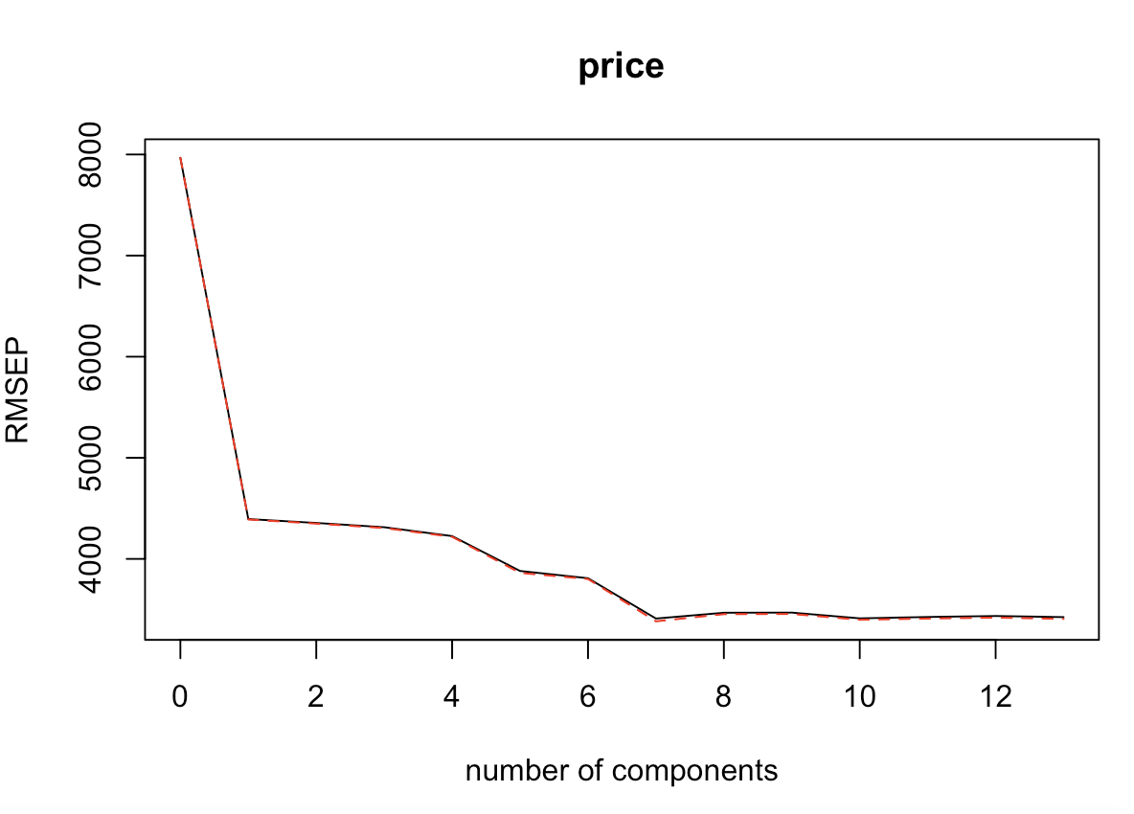
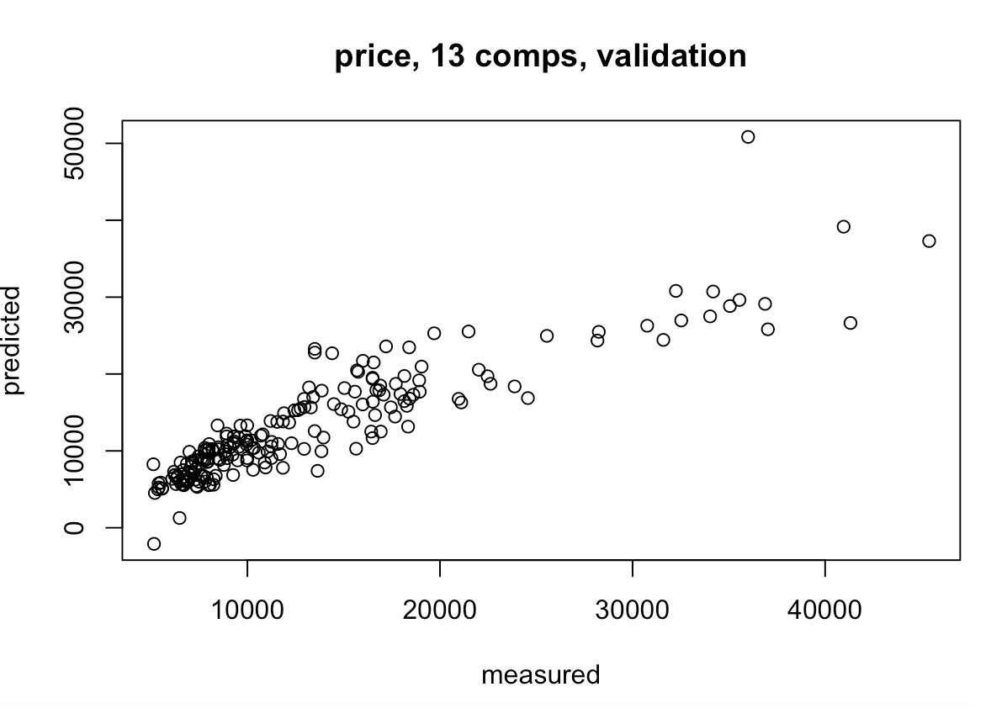
Principal Component Regression
Principal Component Regression: Assumption of PCR is that the directions in which the predictors show the most variation are the exact directions associated with the response variable.
Validation Plot Showing the RMSE
Prediction Plot

Slide 20
Principal Component Analysis for Dummy Variables

Slide 21
Principal Component Analysis for Dummy
Package Used: PCA Mixdata
This package divides the variables into Quantitative and Qualitative
100% variance is Explained by 62 dimensions
We consider 19 dimensions which explain 74.99949 of the total variance
This is not a suitable method as it requires many dimensions to achieve a threshold variance
The sum of rotation variance is 39.5578 which is very less and clearly not a good approach
100% variance is Explained by 62 dimensions
Method | RMSE
PCR | 4200
Linear Regression | 3137.239
We clearly see that the Mean Square Error is high for PCR when compared to the Linear Regression Model which clearly says that it is not a good choice over Linear Regression
Also from the results we observe that using the dummy variables might not be not an efficient choice.

Slide 22
Common Factor Analysis

Slide 23
Common Factor Analysis
Why Common Factor Analysis?
It allows researchers to investigate concepts that are not easily measured directly by collapsing a large number of variables into a few interpretable underlying factors.
The key concept of factor analysis is that multiple observed variables have similar patterns of responses because they are all associated with a latent variable.
CFA often used for theoretical Solution uncontaminated by Unique and Error Variability.

Slide 24
Common Factor Analysis
F1
100% variance was explained by 14 Components, but with the help of Kaiser-Meyer method, we selected 3 Factors which explains 71.2% proportion of variance.
F2
Factors | Component Loading | Percent of Variance Explained
1 | 6.308 | 45.1%
2 | 2.211 | 15.8%
3 | 1.447 | 10.3%
F3
AB Line

Slide 25
Common Factor Analysis vs. Principal Component Analysis
Factors Explained:
Components Explained:
Factors | Component Loading | Percent of Variance Explained
1 | 6.308 | 45.1%
2 | 2.211 | 15.8%
3 | 1.447 | 10.3%
Component | Component Loading | Percent of Variance Explained
1 | 7.124 | 50.9%
2 | 2.618 | 18.7%
3 | 1.210 | 8.6%
Factor analysis gives 71.2% cumulative proportion of variance with first three factors while PCA gives 78.2% proportion of variance. This is because PCA uses all unique and error variance while Factor Analysis only uses the shared variance.

Slide 26
Linear Regression Model

Slide 27
Linear Regression Model
Target
Predicting value for different automobiles
Procedure
Select model as Linear Regression Model
Remove highly correlated variables.
Check for VIF
Create Dummy variables and split data into training and testing by 80:20 ratio.
Train and predict the model.
Formula for Linear Regression
y = -53737.59 + horsepower*(157.60) + make*(-165.531) + wheel_base*(243.51) + fuel_type*(-5473.65) + aspiration*(-3998.945) + engine_type*(329.381) + width*(511.30)

Slide 28
Linear Regression Model - Contd.
Dep. Variable: | price | R-squared: | 0.947
Model: | OLS | Adj. R-squared: | 0.945
Method: | Least Squares | F-statistic: | 497.8
No of Observation: | 201 | Prob (F-statistic): | 2.83e-120
RMSE | 3137.239
coef | P>|t| | Std err. | t
horsepower | 0.000 | 7.86 | 23.067
make | 0.000 | 41.129 | -4.759
wheel_base | 0.000 | 71.611 | 5.566
fuel_type | 0.000 | 991.83 | -8.011
aspiration | 0.000 | 786.86 | -4.626
engine_type | 0.107 | 304.50 | 1.617
width | 0.000 | 113.772 | -4.76
Notes:
Wheel_base, Length, Width, curb_weight, Engine_size, Bore, Horsepower, City_mpg, Highway_mpg, price -> these are variables in PC1 which has maximum variance, so if they match you can tell even from PC1 we observed that they are important.

Slide 29
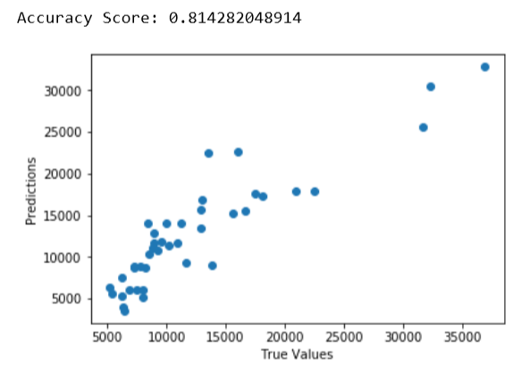
Linear Regression Model - Contd.
We got Accuracy score of 80% using
7 variables.
Plot show right-skew distribution.
Is this accuracy correct? What if the split isn’t
random ? This will result into overfitting.

Slide 30
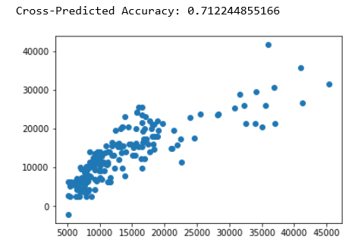
Linear Regression Model - Contd.
We will validate the model using Cross Validation
Using 3 fold Cross Validation
Cross-validated scores: [ 0.81528056 0.71027709 0.14462152]
Cross-Predicted Accuracy = 70%
Plot show right-skewed distribution

Slide 31
Decision Tree

Slide 32
Decision Tree
Purpose of using this method and how it can be useful
Decision trees are simpler classification models, ideal for technical and non-technical audience
They are mainly used to predict categorical variables.
In our dataset there is an important variable named as Symbolling which is ideal to determine the risk of insurance based upon different variables.
Different insurance companies usually determine their insurance prices based upon driver’s driving behavior based upon accidents however this method can be useful for insurance of first time drivers.

Slide 33
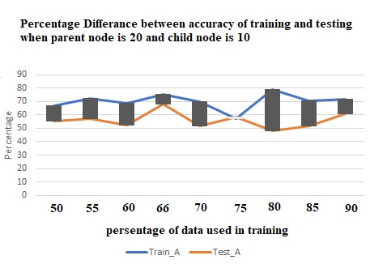
Decision Tree - Contd.
Steps taken before building decision tree model
Initially ran a spearman's correlation method to check correlation between categorical as well continuous variables.
After correlation we ran several different combination of dividing the data in training and testing which were following:
50-50%, 55-45%, 60-40%,
66-34%,70-30%, 75-25%,
80-20%, 85-15%, 90 - 10% training and testing respectively
and after all of that 66 and 34% gave us the least accuracy difference so we decided to use that split.

Slide 34
Decision Tree - Contd.
Criteria to choose the best Model:
Parent Node | Child Node | Training Accuracy | Testing Accuracy | Terminal Node | Depth
50 | 25 | 63.2% | 47.7% | 4 | 3
40 | 20 | 61.5% | 63.6% | 4 | 3
30 | 15 | 66.7% | 50% | 4 | 2
20 | 10 | 75.6% | 68.2% | 6 | 3
15 | 8 | 73.2% | 60.6% | 7 | 3
Methods used:
Hold out partitioning with 66% training and 34% as testing
Gini index to measure impurity in Nodes
CRT method was used to build the model.
Model was created with giving importance to variables.

Slide 35
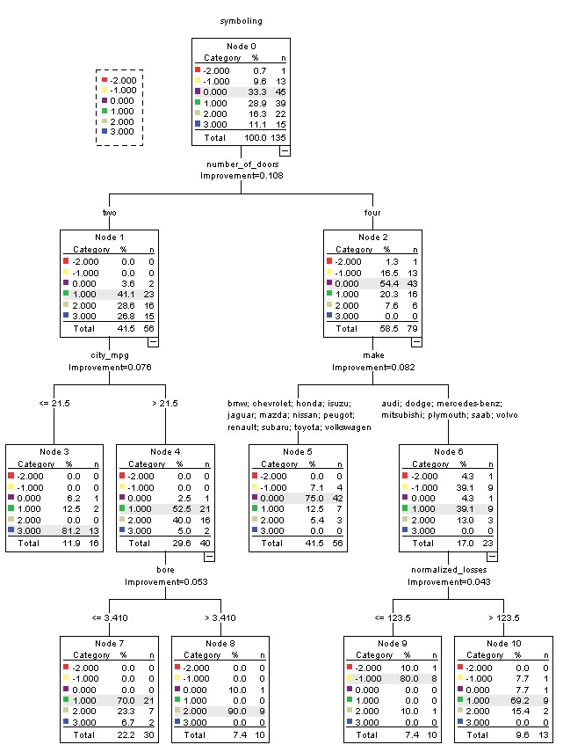
Decision Tree - Results
Important Variables:
Number of doors
City Mileage per gallon
Make
Bore
Normalized Losses Improvement
Example of Rule:
For non Technical audience:
If a car has two doors and in city area the mileage per gallon while driving is less than 21.5 then 81.2% chances are that the auto has more risk when it comes to insurance
For Technical audience:
If number_of_doors == two and city_mpg improvement=0.076 <= 21.5 then risk == 3.00

Slide 36
Conclusion
Which model results looking promising for our definition and why?
For our research question we wanted to predict the key determining points to predict the price of the car and safety level of a consumer to provide insurance to him/her.
The Linear Regression model provides the solution to us with price predicting model and the variable in the equation represents the importance of the certain variables which plays a key role in order to predict the price
The Decision tree focuses on prediction of “Symboling”, where we are getting 75% training accuracy and 68.2% testing accuracy with 3 node depth which is ideal for classification model.
Notes:
So, Both of our final models are equally important

Slide 37
Possible Future Work
As of now our current techniques looks promising, but by improvising the model by adding more data, can give more accurate results and could possibly give a real world applicable model.
For classification on symboling purpose we can use KNN(K-Nearest Neighbor), Hierarchical Clustering, K means Clustering, and LDA(Linear Discriminant Analysis).

Slide 38
References [1] https://en.wikipedia.org/wiki/Principal_component_regression [2] http://www.win-vector.com/blog/2016/05/pcr_part1_xonly/ [3] https://en.wikipedia.org/wiki/Decision_tree [4] https://towardsdatascience.com/simple-and-multiple-linear-regression-in-python [5] https://homes.cs.washington.edu/~nasmith/papers/nguyen+smith+rose.latech11.pdf

Slide 39
Feedback

Slide 40
Thank You

